Slide 1
Vocabulary of Attributes

Slide 2
Standard Attribute Paradigms
Feather
Wing
Leg
…
Models/Classifiers
Features
What to learn
(Vocabulary of attributes)
Learn the attribute models
Use Attributes
Slide: Ali Farhadi

Slide 3
Where to ask for semantics
From the beginning
Known vocbulary
Unknown attribute-category relations
Discovering the vocabulary of attributes
Human in the loop
Weakly supervised
Semantics interleaved with discriminative power
Delaying Semantics
Never
Slide: Ali Farhadi

Slide 4
From the beginning
Slide: Christoph Lampert

Slide 5
Slide: Christoph Lampert

Slide 6
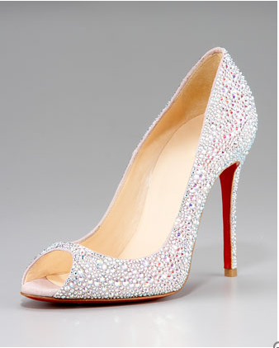
Automatically Discovering Attributes from Noisy Web Data
T.L. Berg, A.C. Berg, J. Shih ECCV 2010
Fully beaded with megawatt crystals, this Christian Louboutin suede pump matches the gleam in your eye.
Pump's linear heel plays up the alluring curves of its dipped sides.
Round toe frames low-cut vamp.
Tonally topstitched collar.
4" straight, covered heel shows off signature red sole.
Creamy leather lining with padded insole.
"Fifi" is made in Italy.
Learn which terms in descriptions are depictable
attributes
Slide: Tamara Berg

Slide 7
Given Web Images + Noisy Text Descriptions:
1) Discover visual attribute terms in text descriptions - likely domain dependent
2) Learn appearance models for attributes without labeled data
3) Characterize attributes by: type, localizability
Slide: Tamara Berg

Slide 8
How can we discover attributes?
1. Use commonly occurring phrases as hypothesized attributes
2. Train classifier to recognize images for each phrase
3. High accuracy on held-out data → visual attribute

Slide 9
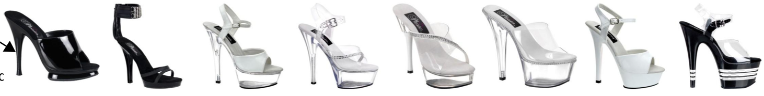
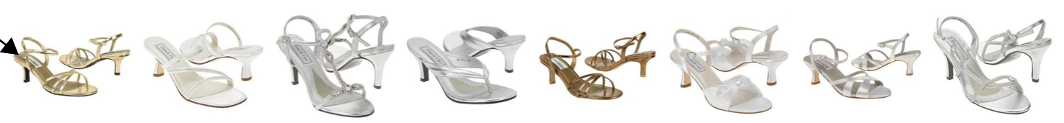
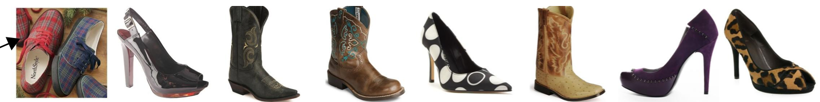
Evaluate Hypothesized Attributes
Front platform
Sandal style round
Appeal
Slide: Tamara Berg

Slide 10
Evaluate Hypothesized Attributes
Clutch
Hobo
Essentials
Slide: Tamara Berg

Slide 11
Ranked Attributes
Slide: Tamara Berg

Slide 12
Identify Visual Synsets automatically from similarity of classifier outputs
Example Handbag Synsets
{“hobo”, “handbags”, “top,zip,closure”, “shoulder,bag”, ...}
{“tote”, “handles”, “straps”, “lined”, “open”...}
{“silver”, “metallic” }
Example Shoe Synsets
{“sandal style round”, “sandal style round open”, “dress sandal”, …}
{“stiletto”, “stiletto heel”, “sexy”, “traction”, “fabulous”, “styling”}
{“running shoes”, “synthetic mesh”, “mesh”, “stability”, “molded”...}
Slide: Tamara Berg

Slide 13
How can we characterize attributes?
Localizability (local or global):
Treat image as a bag of regions, label associated with the bag.
Learn a MILBoost classifier to associate label probabilities with regions.
Tightly clustered probabilities -> attribute is localizable.
Notes:
We can also classify the localizability of attributes -- reflecting whether the attribute corresponds to a global characteristic of the object (like the color) or a more local characteristic like the shape or height of the heel.
To do this we frame the problem in a multiple instance learning framework where we treat each image as a bag of regions with a label associated with the bag rather than individual regions.
Then we learn a boosted classifier using Multiple instance learning for the attribute. This gives us a classifier to predict attributes as well as a weight on each region which denotes the probability of the attribute on a region.
If regions with high probability across the data set are tightly clustered relative to the object then we can predict that the attribute is localizable.

Slide 14
Attribute Characterization

Slide 15
Known Attribute Vocabulary Unknown Attribute-Class Relations

Slide 16
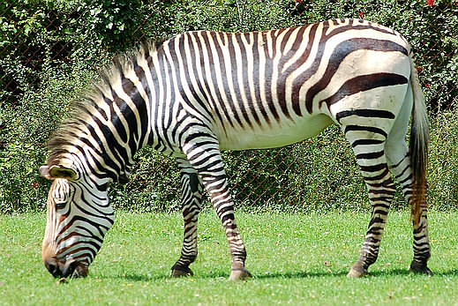
Joint Framework
Learn
jointly
Binary Attribute Classifiers
Stripes
Hooves
Tail
Water
Smelly
Attribute
Vector
1 1 1 0 0
D. Mahajan, S. Sellamanickam, and V. Nair. A joint learning framework for attribute models and
object descriptions. In ICCV, 2011

Slide 17
Input
Class Labeled
Dolphin Zebra
Classes
Easily Obtainable
Class – attribute
mapping not known
Attributes
Smelly
Water
Timid
Training examples for attributes
D. Mahajan, S. Sellamanickam, and V. Nair. A joint learning framework for attribute models and
object descriptions. In ICCV, 2011

Slide 18
Goal
Class Labeled
Dolphin Zebra
Classes
Class – attribute
mapping not known
Learn
jointly
Attributes
Smelly
Water
Timid
Classifiers
Training examples for attributes
D. Mahajan, S. Sellamanickam, and V. Nair. A joint learning framework for attribute models and
object descriptions. In ICCV, 2011

Slide 19
Previous Approaches
Class Labeled
Then do
classification
Dolphin Zebra
Farhadi et al. 09
Lampert et al. 09
Classes
Known
mapping
Bottom-up
Influence only
Attributes like Smelly,
Timid do not help in
classification
Attributes
Smelly
Water
Timid
0.53 0.89 0.59
AUC
Classifiers
Training examples for attributes
Learn classifiers first
D. Mahajan, S. Sellamanickam, and V. Nair. A joint learning framework for attribute models and
object descriptions. In ICCV, 2011

Slide 20
The Joint Approach
Class Labeled
Dolphin Zebra
Classes
Attributes
Smelly
Water
Timid
0.53 0.89 0.59
AUC
Classifiers
Training examples for attributes
D. Mahajan, S. Sellamanickam, and V. Nair. A joint learning framework for attribute models and
object descriptions. In ICCV, 2011

Slide 21
Our Joint Approach
Class Labeled
Dolphin Zebra
Use class
labeled data
Classes
Top-down
Influence
Attributes
Smelly
Water
Timid
Bottom-up
Influence
0.53 0.89 0.59
AUC
Classifiers
Training examples for attributes

Slide 22
Formulation
- Attribute classifiers
- Attribute vectors of known class k
Standard binary attribute
Classifier term
Uses training examples
available for each attribute
Logistic regressor model
D. Mahajan, S. Sellamanickam, and V. Nair. A joint learning framework for attribute models and
object descriptions. In ICCV, 2011

Slide 23
Formulation
- Attribute classifiers
- Attribute vectors of known class k
Standard binary attribute
classifier term
Captures interaction between
attribute vectors of known
classes and attribute classifiers
Uses training examples
available for each attribute
Uses known class labeled data
For each class k, attribute vectors of all its images predicted using should cluster tightly around
Logistic regressor model
D. Mahajan, S. Sellamanickam, and V. Nair. A joint learning framework for attribute models and
object descriptions. In ICCV, 2011

Slide 24
Formulation
- Attribute classifiers
- Attribute vectors of known class k
Standard binary attribute
classifier term
Captures interaction between
attribute vectors of known
classes and attribute classifiers
Atrribute vector regularizer
Uses training examples
available for each attribute
Uses known class labeled data
Row Separation
For each class k, attribute vectors of all its images predicted using should cluster tightly around
Logistic regressor model
Column Separation
D. Mahajan, S. Sellamanickam, and V. Nair. A joint learning framework for attribute models and
object descriptions. In ICCV, 2011

Slide 25
Attribute Vector Regularization
Row Separation:
Smelly Water Timid
Zebra
Dolphin
Rat
0 0 1
Maintain some mean
hamming distance
0 1 1
1 0 1
Makes sure that flipped attributes like smelly are discriminative
Column Separation:
Smelly Water Timid
Zebra
Dolphin
Rat
0 0 1
0 1 1
1 0 1
Measures correlation
Zero correlation removes redundancy among attributes
Minimize KL-divergence with user-specified Gaussian distribution over hamming
distance and correlations

Slide 26
Classification Accuracy
Known classes
Hard
Baseline
Dataset | CLB1 | CLB2/CLB3 | Our (Basic)
AwA (Cut 1) | 30.92 | 54.00 | 54.62
AwA (Cut 2) | 21.51 | 44.90 | 46.43
AwA (Cut 3) | 18.77 | 51.40 | 52.04
AwA (Cut 4) | 23.02 | 49.50 | 50.83
a-Pascal | 30.83 | 62.01 | 67.33
D. Mahajan, S. Sellamanickam, and V. Nair. A joint learning framework for attribute models and
object descriptions. In ICCV, 2011

Slide 27
Classification Accuracy
Unseen/Unknown classes
Dataset | CLB2 | CLB3 | Our (Basic) | Our (Transductive)
AwA (Cut 1) | 26.17 | 26.8 | 28.28 | 33.61
AwA (Cut 2) | 24.89 | 26.34 | 25.57 | 31.00
AwA (Cut 3) | 27.02 | 27.12 | 28.96 | 32.33
AwA (Cut 4) | 22.00 | 27.65 | 27.48 | 33.34
a-Pascal | 28.14 | 28.78 | 29.77 | 37.93

Slide 28
Importance of Joint Learning
Stage-wise Learning
Classifiers and attribute vectors learned separately
AwA
10% improvement over known classes
3% improvement over unseen classes
a-Pascal, a-Yahoo
8% improvement over known classes
3% improvement over unseen classes

Slide 29
Attribute Regularization
 | AwA |  |  |  | a-Pascal
 | Cut 1 | Cut 2 | Cut 3 | Cut 4
Without Regularization | 49.58 | 42.60 | 44.51 | 48.99 | 60.31
Column Separation | 53.00 | 45.85 | 45.89 | 48.17 | 63.44
Row Separation | 54.71 | 45.80 | 48.21 | 51.30 | 67.33
Both | 54.62 | 46.43 | 52.04 | 50.83 | 67.33
Average decrease in correlation of attributes – 22%

Slide 30
Unknown Attribute vocabulary

Slide 31
Attribute Discovery
Human in the Loop

Slide 32
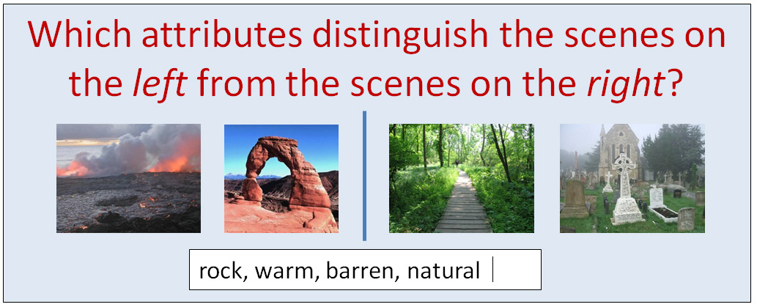
Which Scene Attributes are Relevant?
Inspired by the “splitting” task of Oliva and Torralba and “ESP game” by von Ahn and Blum.
Genevieve Patterson, James Hays. SUN Attribute Database: Discovering, Annotating, and Recognizing Scene Attributes. Proceedings of CVPR 2012

Slide 33
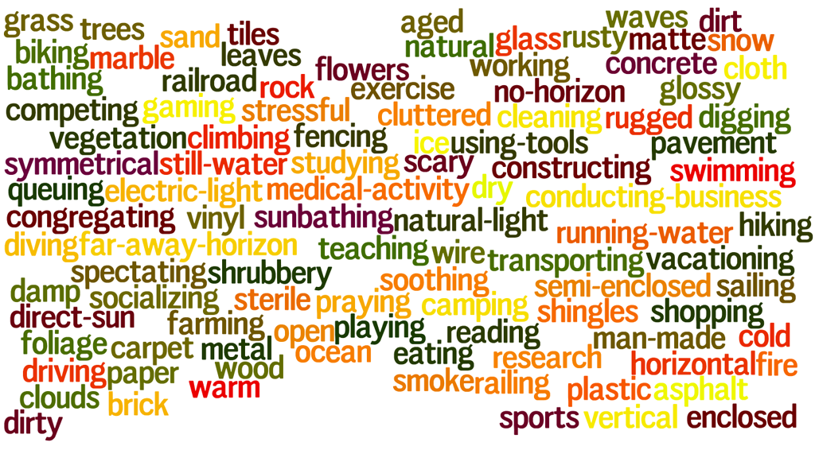
102 Scene Attributes
Genevieve Patterson, James Hays. SUN Attribute Database: Discovering, Annotating, and Recognizing Scene Attributes. Proceedings of CVPR 2012

Slide 34
Genevieve Patterson, James Hays. SUN Attribute Database: Discovering, Annotating, and Recognizing Scene Attributes. Proceedings of CVPR 2012

Slide 35
Genevieve Patterson, James Hays. SUN Attribute Database: Discovering, Annotating, and Recognizing Scene Attributes. Proceedings of CVPR 2012

Slide 36
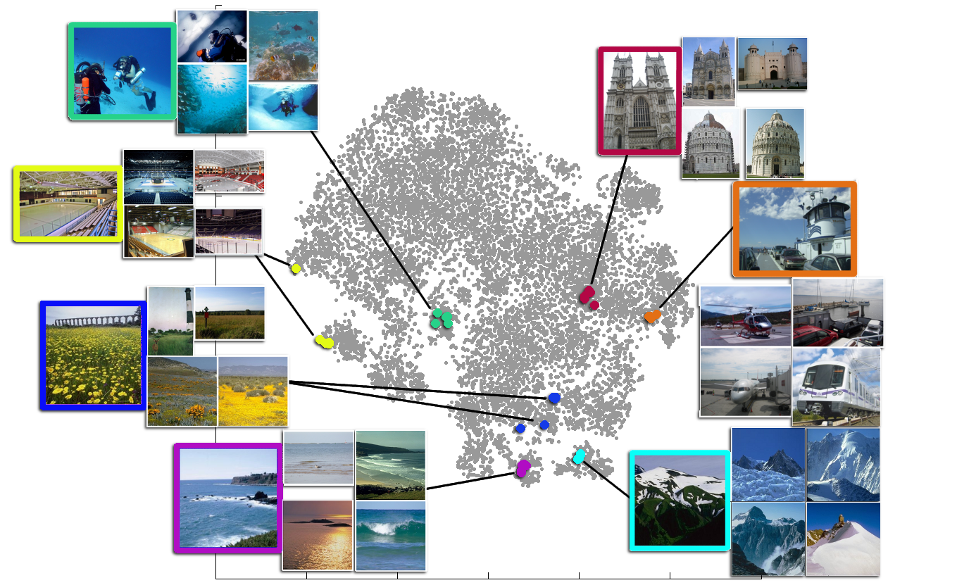
102 dimensional attribute space reduced to 2d with t-SNE

Slide 37
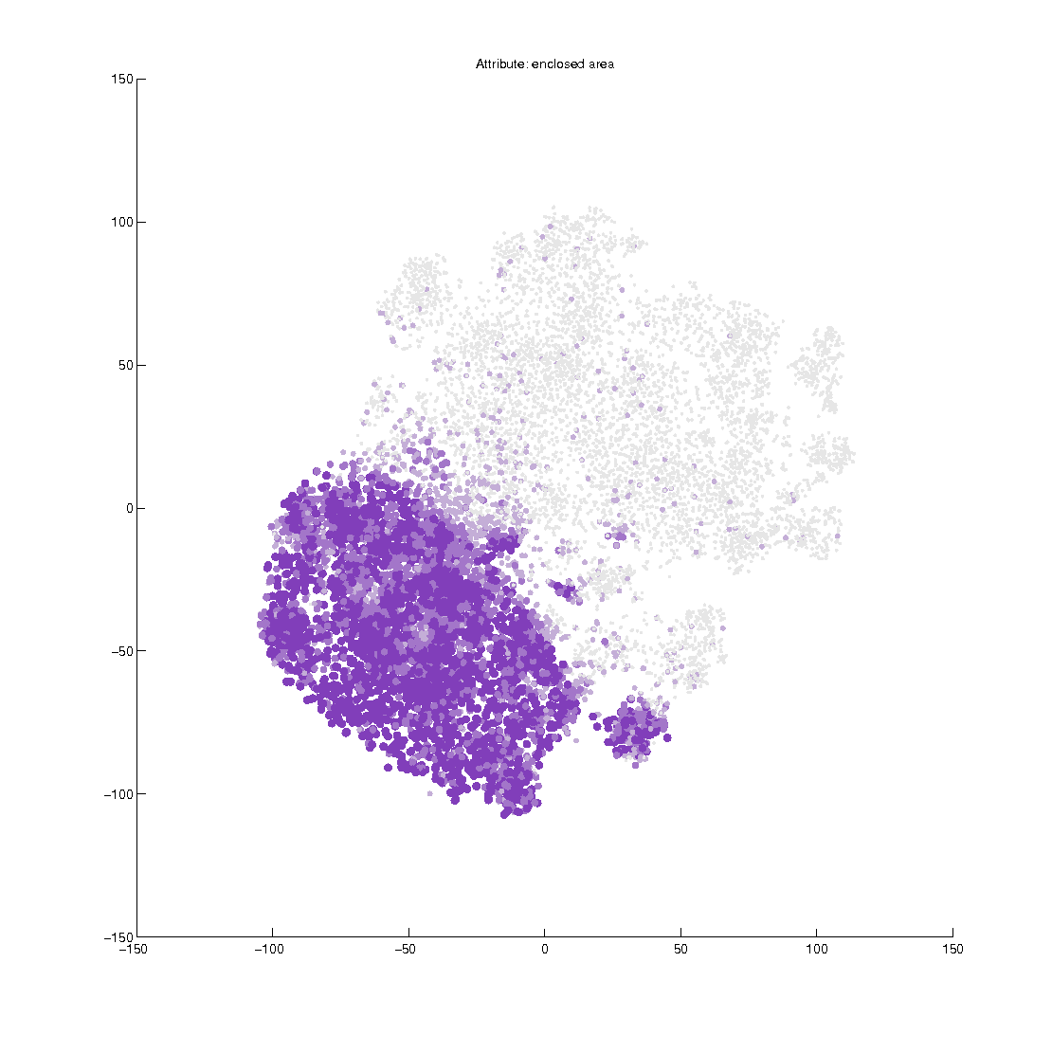
Enclosed Area

Slide 38
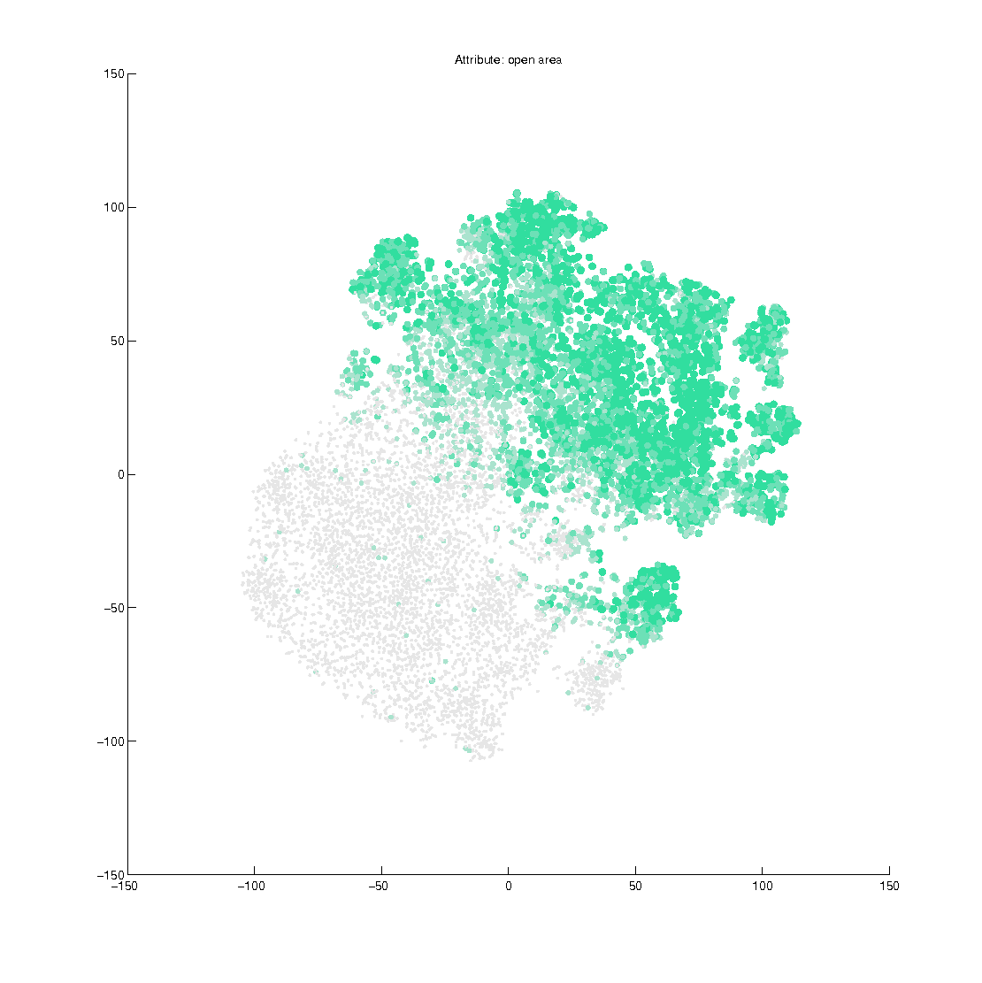
Open Area

Slide 39
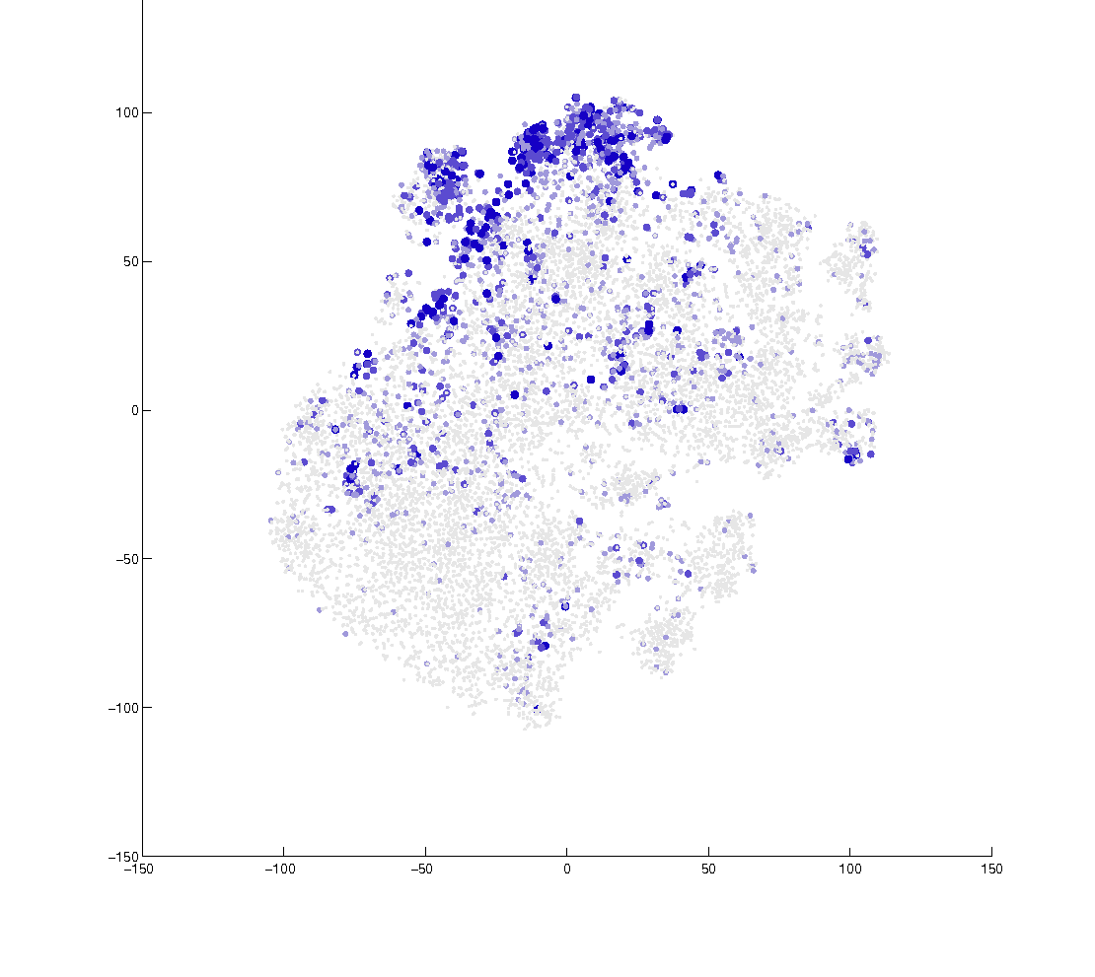
Transport

Slide 40
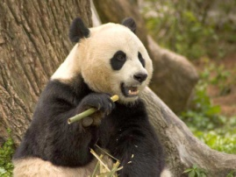
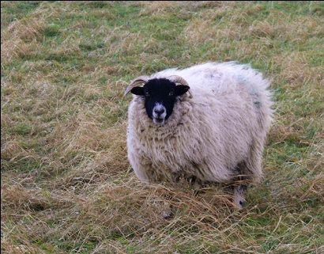
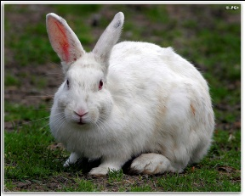
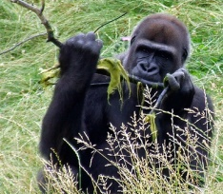
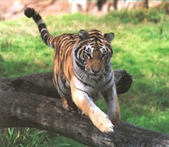
Knowledge transfer for zero-shot object class recognition
Unseen class
(no training images)
Giant panda ?
Attributes for knowledge transfer
Describing using attributes
[Farhadi et al., CVPR `09 & `10]
Manual supervision:
Attribute labels
Group classes by attributes
[Lampert et al., CVPR `09]
Manual supervision:
Object class-attribute associations
animal
four legged
mammal
white
paw

Slide 41

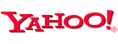
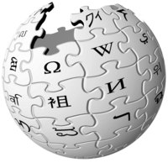

Knowledge transfer for zero-shot object class recognition
Attributes for knowledge transfer
Replace manual supervision by semantic relatedness mined from language resources
Unsupervised Transfer
Unseen class
(no training images)
Giant panda ?
Attributes for knowledge transfer
WordNet
Describing using attributes
[Farhadi et al., CVPR `09 & `10]
Manual supervision:
Attribute labels
Group classes by attributes
[Lampert et al., CVPR `09]
Manual supervision:
Object class-attribute associations
animal
four legged
mammal
white
paw

Slide 42
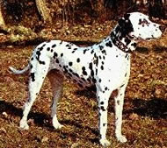
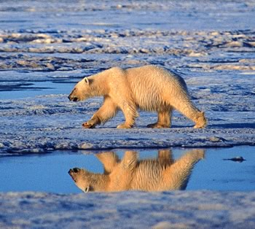
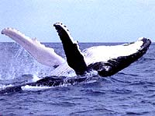
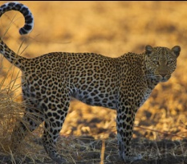
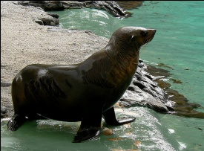
Attribute-based model
Known training classes
Class-attribute associations
Supervised:
manual (human judges)
Attributes
Attribute classifiers
spots
white
ocean
…
Class-attribute associations
Unseen test classes

Slide 43
Attribute-based model
Known training classes
Class-attribute associations
semantic relatedness
from language
Supervised:
manual (human judges)
Attribute classifiers
spots
white
ocean
…
Word Net
Class-attribute associations
Unseen test classes

Slide 44
Direct similarity-based model
Known training classes
Class-attribute associations
semantic relatedness
from language
Attribute classifiers
spots
white
ocean
…
Word Net
Class-attribute associations
Unseen test classes

Slide 45
Direct similarity-based model
Known training classes
semantic relatedness
from language
Classifier
per class
polar bear
killer whale
Dalmatian
Word Net
Class-attribute associations
Unseen test classes

Slide 46
Direct similarity-based model
Known training classes
semantic relatedness
from language
Classifier
per class
…
Dalmatian
polar bear
killer whale
Word Net
most similar classes
Unseen test classes

Slide 47
Semantic Relatedness Measures
WordNet
[Fellbaum, MIT press `98]
WordNet
Lin measure [Budanitsky & Hirst, CL `06]
Wikipedia
Explicit Semantic Analysis [Gabrilovich & MarkovitchI, IJCAI `07]
Word Wide Web
Hitcount (Dice coeffient) [Kilgarriff & Grefenstette, CL `03]
Image search
Visually more relevant
Hitcount (Dice coeffient)

Slide 48
Semantic Relatedness Measures
WordNet
[Fellbaum, MIT press `98]
WordNet
Lin measure [Budanitsky & Hirst, CL `06]
Wikipedia
Explicit Semantic Analysis [Gabrilovich & MarkovitchI, IJCAI `07]
Word Wide Web
Hitcount (Dice coeffient) [Kilgarriff & Grefenstette, CL `03]
Image search
Visually more relevant
Hitcount (Dice coeffient)

Slide 49
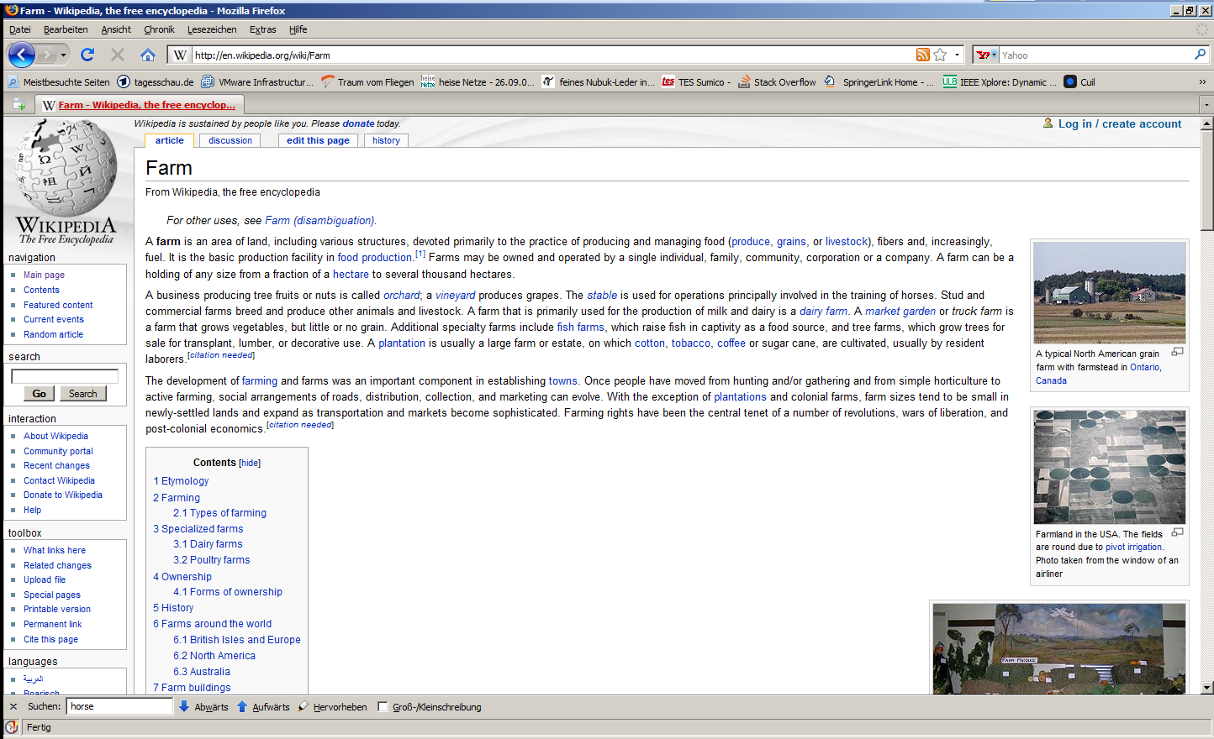
Semantic Relatedness Measures
WordNet
Lin measure [Budanitsky & Hirst, CL `06]
Wikipedia
Explicit Semantic Analysis [Gabrilovich & MarkovitchI, IJCAI `07]
Word Wide Web
Hitcount (Dice coeffient) [Kilgarriff & Grefenstette, CL `03]
Image search
Visually more relevant
Hitcount (Dice coeffient)
Article | horse | elephant
Farm | 3 | 0
Hoof | 2 | 1
Tusk | 0 | 4
… | … | …
Farm
Farm
A farm is an area of lan the training of horses.
A farm is an area of lan the training of horses.
Hoof
Hoof
A hoof is the tip of a toe
Rear hooves of a horse
A hoof is the tip of a toe
Rear hooves of a horse
Most evem tped ungulat
Tusk
Tusk
Tusks are long teeth, u
Elephants and narwhals
Tusks are long teeth, u
Elephants and narwhals

Slide 50
Semantic Relatedness Measures
WordNet
Lin measure [Budanitsky & Hirst, CL `06]
Wikipedia
Explicit Semantic Analysis [Gabrilovich & MarkovitchI, IJCAI `07]
Word Wide Web
Hitcount (Dice coeffient) [Kilgarriff & Grefenstette, CL `03]
Image search
Visually more relevant
Hitcount (Dice coeffient)
Article | horse | elephant
Farm | 3 | 0
Hoof | 2 | 1
Tusk | 0 | 4
… | … | …
Farm
Farm
A farm is an area of lan the training of horses.
A farm is an area of lan the training of horses.
cosine
Hoof
Hoof
A hoof is the tip of a toe
Rear hooves of a horse
A hoof is the tip of a toe
Rear hooves of a horse
Most evem tped ungulat
Tusk
Tusk
Tusks are long teeth, u
Elephants and narwhals
Tusks are long teeth, u
Elephants and narwhals

Slide 51
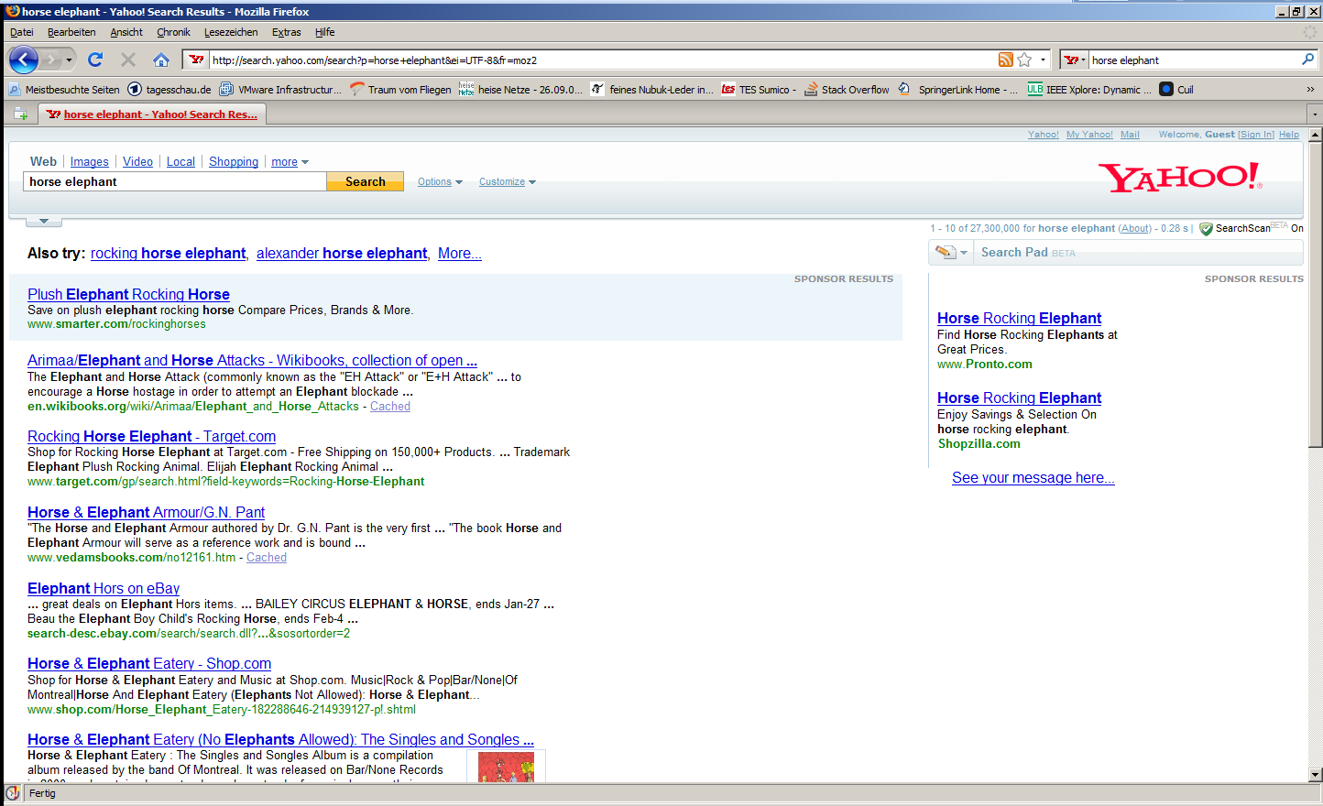
Semantic Relatedness Measures
WordNet
Lin measure [Budanitsky & Hirst, CL `06]
Wikipedia
Explicit Semantic Analysis [Gabrilovich & MarkovitchI, IJCAI `07]
Word Wide Web
Hitcount (Dice coeffient) [Kilgarriff & Grefenstette, CL `03]
Image search
Visually more relevant
Hitcount (Dice coeffient)

Slide 52
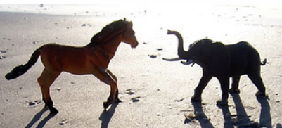
Semantic Relatedness Measures
WordNet
Lin measure [Budanitsky & Hirst, CL `06]
Wikipedia
Explicit Semantic Analysis [Gabrilovich & MarkovitchI, IJCAI `07]
Word Wide Web
Hitcount (Dice coeffient) [Kilgarriff & Grefenstette, CL `03]
Image search
Visually more relevant
Hitcount (Dice coeffient)
web search
image search
We watched a horse race yesterday. [..] Tomorrow we go in the zoo to look at the baby elephant.
[http://www.flickr.com/photos/ lahierophant/2099973716/]
„the dance of the horse and elephant“
Incidental co-occurence
Terms refer to same entity (the image)

Slide 53
Performance of supervised approach

Slide 54
Querying class-attribute association
Performance of queried association
Encouraging
Below manual supervision
Image search
Based on image related text
Wikipedia
Robust resource
Yahoo Web
Very noisy resource
WordNet
Path length poor indicator of class-attribute associations
Querying: abbreviation agile
Manual supervision: detailed description “having a high degree of physical coordination”

Slide 55
Querying class-attribute association
Performance of queried association
Encouraging
Below manual supervision
Image search (Yahoo Img, Flickr)
Based on image related text
Wikipedia
Robust resource (definition texts)
Yahoo Web
Very noisy resource
WordNet
Path length poor indicator of class-attribute associations
image search
the dance of the horse and elephant

Slide 56
Querying class-attribute association
Performance of queried association
Encouraging
Below manual supervision
Image search (Yahoo Img, Flickr)
Based on image related text
Wikipedia
Robust resource (definition text)
Yahoo Web
Very noisy resource
WordNet
Path length poor indicator of class-attribute associations
Noise:
While he watched a horse race the leg of his chair broke.

Slide 57
Querying class-attribute association
Performance of queried association
Encouraging
Below manual supervision
Image search (Yahoo Img, Flickr)
Based on image related text
Wikipedia
Robust resource (definition text)
Yahoo Web
Very noisy resource
WordNet
Path length poor indicator of class-attribute associations

Slide 58
Mining attributes
Known training classes
Class-attribute associations
semantic relatedness
from language
Attribute terms
spots
white
ocean
…
Word Net
Class-attribute associations
Unseen test classes

Slide 59
Mining attributes
Known training classes
Class-attribute associations
semantic relatedness
from language
Attribute terms
?
?
?
?
Word Net
Class-attribute associations
Unseen test classes

Slide 60
Mining attributes
Known training classes
Class-attribute associations
semantic relatedness
from language
Attribute classifiers
Part attributes
Leg of a dog
leg
paw
flipper
Word Net
Word Net
Class-attribute associations
Unseen test classes

Slide 61
Mining attributes
Additional measure: Holonym patterns
Only part attributes
Hit Counts of Patterns [Berland & Charniak, ACL 1999]
“cow’s leg”
“leg of a cow”
Dice coefficient
web search
holonym patterns
While he watched a horse race the leg of his chair broke.
Leg of the horse
Incidental co-occurence
One term likely part of other term

Slide 62
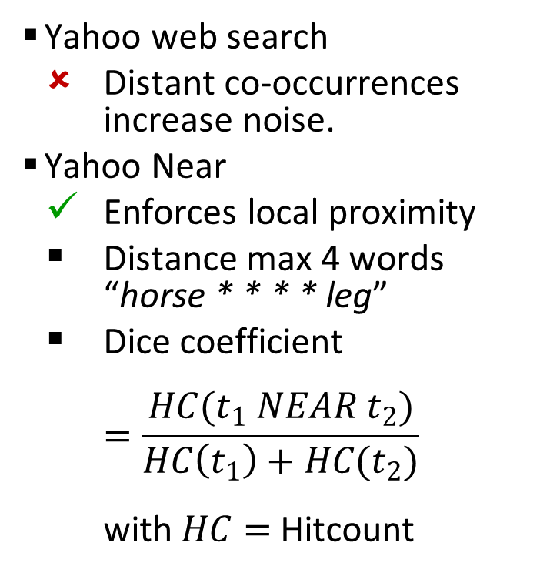
Yahoo Near [Delezoide et al., OntoImage `08]
Yahoo web search
Distant co-occurrences increase noise.
Yahoo Near
Enforces local proximity
Distance max 4 words “horse * * * * leg”
Dice coefficient $=\frac{HC(t_{1} NEAR t_{2})}{HC\left(t_{1}\right)+HC(t_{2})}$ with $HC=$ Hitcount
Yahoo web search
Yahoo Near
We wanted to go horse riding yesterday. However, on the way to the stables our car had a flat tire.
We wanted to go horse riding yesterday. However, the horse had a broken leg.
Incidental co-occurrence
Terms refer more likely to each other

Slide 63
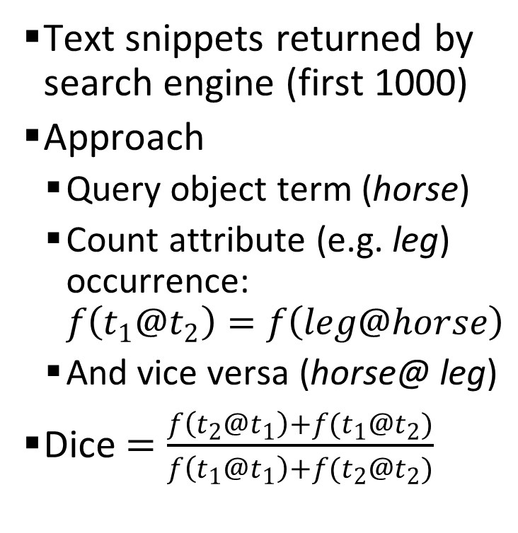
Yahoo Snippets [Chen et al., ACL `06]
Text snippets returned by search engine (first 1000)
Approach
Query object term (horse)
Count attribute (e.g. leg) occurrence:
And vice versa
Dice
Horse Hoof Care and Horse Leg Care Information...
John Lyons Certified horse Trainers give horse training advice and horse product manufacturers provide information at the InfoHorse horse directory Home Page. www.infohorse.com/ - Cached
Terms refer more likely to each other
Notes:
Snippets:
Benefit from Search engine
Relevant text & snippets
-- ranking
-- summary

Slide 64
Expanded Attribute Inventory - Results
Performance improves
In all cases
No. of expanded attributes
164
Cluster associations binary
No threshold to pick

Slide 65
Semantics interleaved with discrimination
Slide: Devi Parikh

Slide 66
Attributes
Attributes are most useful if they are
Discriminative
Nameable
Approaches | Discriminative | Nameable
Slide: Devi Parikh

Slide 67
Attributes
Attributes are most useful if they are
Discriminative
Nameable
Approaches | Discriminative | Nameable
Hand-generated | Maybe not | Yes
Slide: Devi Parikh

Slide 68
Attributes
Attributes are most useful if they are
Discriminative
Nameable
Approaches | Discriminative | Nameable
Hand-generated | Maybe not | Yes
Mining the web | Maybe not | Yes
Slide: Devi Parikh

Slide 69
Attributes
Attributes are most useful if they are
Discriminative
Nameable
Approaches | Discriminative | Nameable
Hand-generated | Maybe not | Yes
Mining the web | Maybe not | Yes
Automatic splits | Yes | Maybe not
Slide: Devi Parikh

Slide 70
Attributes
Attributes are most useful if they are
Discriminative
Nameable
Approaches | Discriminative | Nameable
Hand-generated | Maybe not | Yes
Mining the web | Maybe not | Yes
Automatic splits | Yes | Maybe not
Proposed | Yes | Yes
Slide: Devi Parikh

Slide 71
Interactive System
1. Name: Fluffy
2. Name: x
3. Name: Metal
…
How do we show the user a candidate-attribute?
How do we ensure proposals are discriminative?
How do we ensure proposals are nameable?
Slide: Devi Parikh

Slide 72
Attribute Visualization
Slide: Devi Parikh

Slide 73
Attribute Visualization
Slide: Devi Parikh

Slide 74
Ensure Discriminability
Normalized cuts
Max Margin Clustering
Slide: Devi Parikh

Slide 75
Ensure Nameability
1. Name: Fluffy
2. Name: x
3. Name: Metal
…
Slide: Devi Parikh

Slide 76
Ensure Nameability
1. Name: Fluffy
2. Name: x
3. Name: Metal
…
Mixture of Probabilistic PCA
Slide: Devi Parikh

Slide 77
Interactive System
Slide: Devi Parikh

Slide 78
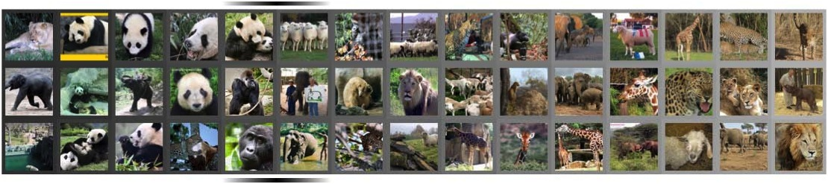

Evaluation
Annotate all candidates off-line
“Black”
… ~25000 responses
Slide: Devi Parikh

Slide 79
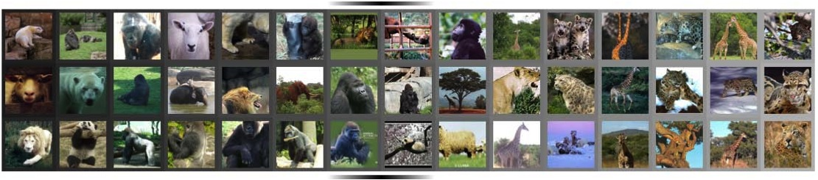
Evaluation
Annotate all candidates off-line
“Spotted”
… ~25000 responses
Slide: Devi Parikh

Slide 80
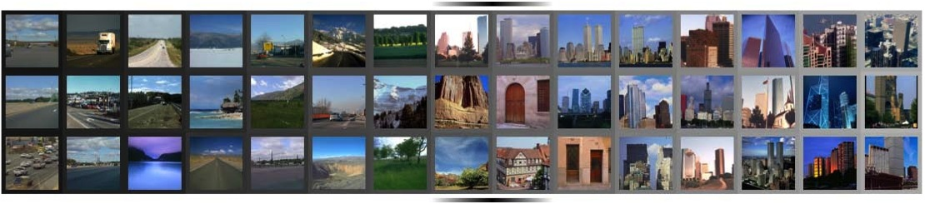
Evaluation
Annotate all candidates off-line
“Congested”
… ~25000 responses
Slide: Devi Parikh

Slide 81
Results
Comparing to discriminative-only baseline
Slide: Devi Parikh

Slide 82
Results
Comparing to descriptive-only baseline
Slide: Devi Parikh

Slide 83
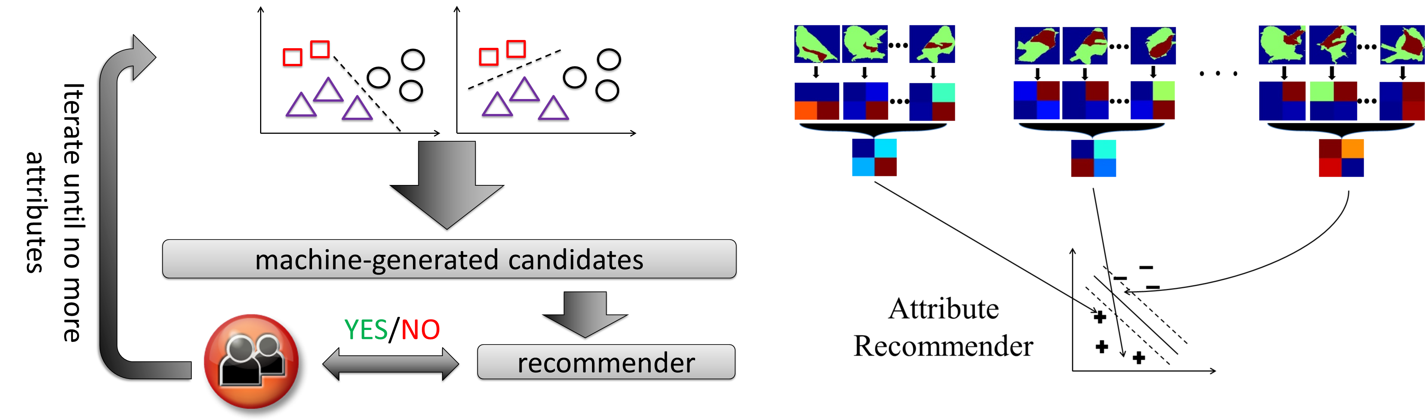
Local Discovered Attributes
K. Duan, D. Parikh, D. Crandall and K. Grauman
Discovering Localized Attributes for Fine-grained Recognition, CVPR12

Slide 84
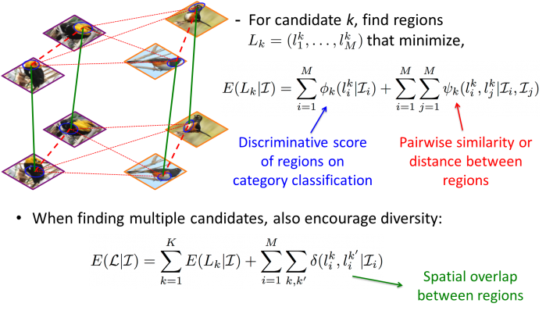
K. Duan, D. Parikh, D. Crandall and K. Grauman
Discovering Localized Attributes for Fine-grained Recognition, CVPR12

Slide 85
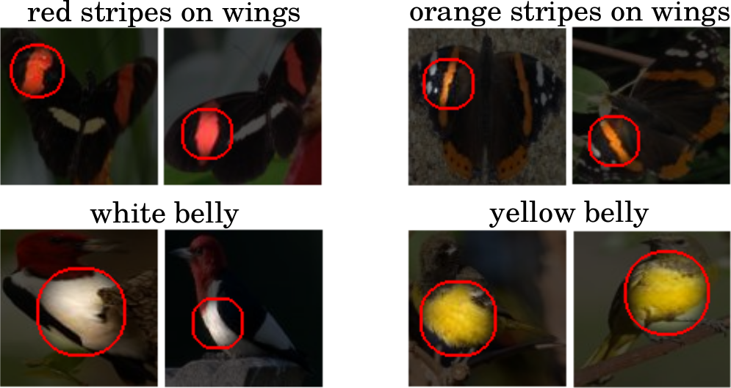
K. Duan, D. Parikh, D. Crandall and K. Grauman
Discovering Localized Attributes for Fine-grained Recognition, CVPR12

Slide 86
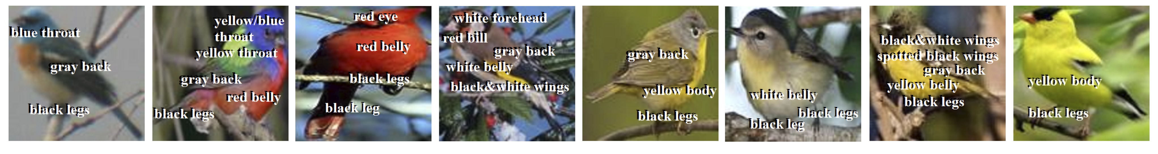
K. Duan, D. Parikh, D. Crandall and K. Grauman
Discovering Localized Attributes for Fine-grained Recognition, CVPR12

Slide 87
Delaying Semantics
A: Predictable from visual data
B: Informative toward categories
Rastegari, Farhadi, Forsyth, Attribute Discovery via Predictable Discriminative Binary Codes, ECCV12

Slide 88
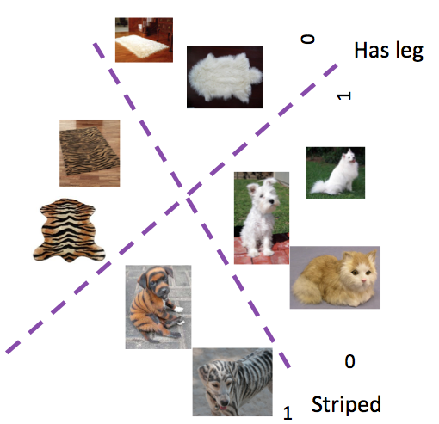
Attribute as a Split
An attribute is a split in the feature space and can be presented by a bit.
010101101
Rastegari, Farhadi, Forsyth, Attribute Discovery via Predictable Discriminative Binary Codes, ECCV12

Slide 89
Rastegari, Farhadi, Forsyth, Attribute Discovery via Predictable Discriminative Binary Codes, ECCV12

Slide 90
Rastegari, Farhadi, Forsyth, Attribute Discovery via Predictable Discriminative Binary Codes, ECCV12

Slide 91
1
0
Rastegari, Farhadi, Forsyth, Attribute Discovery via Predictable Discriminative Binary Codes, ECCV12

Slide 92
1
0
Rastegari, Farhadi, Forsyth, Attribute Discovery via Predictable Discriminative Binary Codes, ECCV12

Slide 93
1
0
Rastegari, Farhadi, Forsyth, Attribute Discovery via Predictable Discriminative Binary Codes, ECCV12

Slide 94
1
0
Rastegari, Farhadi, Forsyth, Attribute Discovery via Predictable Discriminative Binary Codes, ECCV12

Slide 95
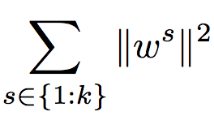
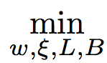
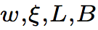
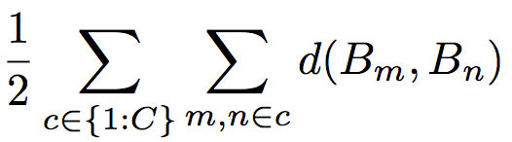
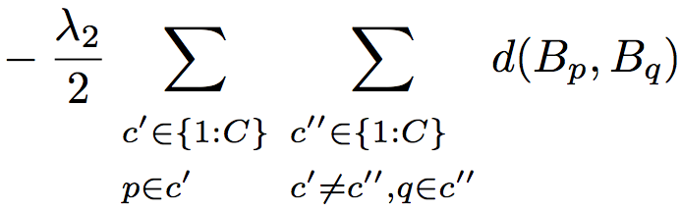
Our Criteria
A: Predictable from visual data
B: Informative toward categories
Rastegari, Farhadi, Forsyth, Attribute Discovery via Predictable Discriminative Binary Codes, ECCV12

Slide 96
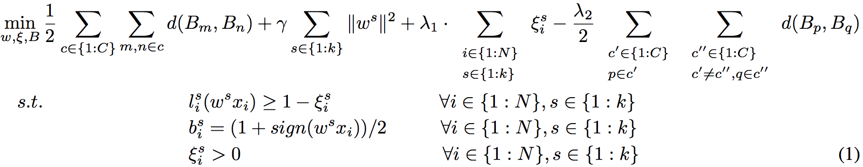
Cute Beast
B_{m}:Binary code for m^{th} image.
d: Distance function.
w^{s}: s^{th} Split (classifier).
k: Code length.
N: Number of training examples
Rastegari, Farhadi, Forsyth, Attribute Discovery via Predictable Discriminative Binary Codes, ECCV12

Slide 97
Rastegari, Farhadi, Forsyth, Attribute Discovery via Predictable Discriminative Binary Codes, ECCV12
Notes:
Going back to our previous toy example,

Slide 98
Rastegari, Farhadi, Forsyth, Attribute Discovery via Predictable Discriminative Binary Codes, ECCV12

Slide 99
1
1
2
3
3
1
2
2
3
1
1
3
2
2
1011001011…0101
1110101101…0010
0001111000…1010
1111111001…0001
1010101010…1001
0001111110…1010
0101101001…1111
1001111000…1010
0001001001…0010
1001110010…1010
1101111000…0010
1101111001…0001
0001111000…0010
1010011011…1111
Category labels
Rastegari, Farhadi, Forsyth, Attribute Discovery via Predictable Discriminative Binary Codes, ECCV12

Slide 100
What do we do?
1
1
2
3
3
1
2
2
3
1
1
3
2
2
1111101011…0101
1110101101…0010
0011111000…1010
1111111001…0001
1010101010…1001
0011101110…1010
0111101001…1111
1001110000…1010
0111001001…0010
1111110010…1010
1001111010…0010
1001111001…0001
0001111000…0010
1010111011…1111

Slide 101
What do we do?
1
1
2
3
3
1
2
2
3
1
1
3
2
2
1111101011…0101
1110101101…0010
0011111000…1010
1111111001…0001
1010101010…1001
0011101110…1010
0111101001…1111
1001110000…1010
0111001001…0010
1111110010…1010
1001111010…0010
1001111001…0001
0001111000…0010
1010111011…1111

Slide 102
What do we do?
1
1
2
3
3
1
2
2
3
1
1
3
2
2
1111101011…0101
1110101101…0010
0011111000…1010
1111111001…0001
1010101010…1001
0011101110…1010
0111101001…1111
1001110000…1010
0111001001…0010
1111110010…1010
1001111010…0010
1001111001…0001
0001111000…0010
1010111011…1111

Slide 103
What do we do?
1
1
2
3
3
1
2
2
3
1
1
3
2
2
1111101011…0101
1110101101…0010
0011111000…1010
1111111001…0001
1010101010…1001
0011101110…1010
0111101001…1111
1001110000…1010
0111001001…0010
1111110010…1010
1001111010…0010
1001111001…0001
0001111000…0010
1010111011…1111

Slide 104
What do we do?
1
1
2
3
3
1
2
2
3
1
1
3
2
2
1110111011…0101
1010001101…0010
0011111100…1010
1101111001…0001
1010100010…1001
0111101110…1010
0111001001…1111
1000110000…1010
0111101001…0010
1110110010…1010
1000111000…0010
1001011001…0001
0001101000…0010
1010111011…1111

Slide 105
What do we do?
1
1
2
3
3
1
2
2
3
1
1
3
2
2
1111101011…0101
1110101101…0010
0011111000…1010
1111111001…0001
1010101010…1001
0011101110…1010
0111101001…1111
1001111000…1010
0111001001…0010
1111110010…1010
1001111000…0010
1001111001…0001
0001111000…0010
1010011011…1111

Slide 106
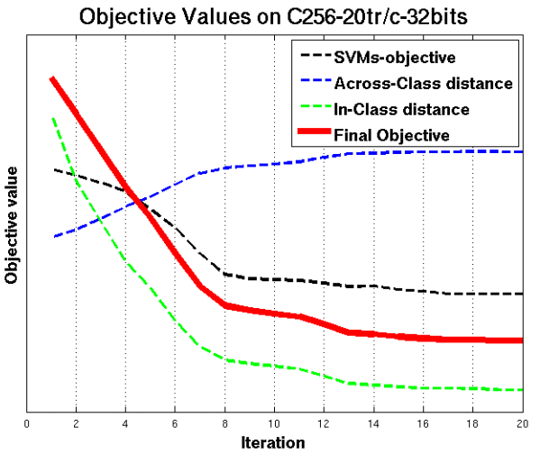
Descending in Optimization

Slide 107
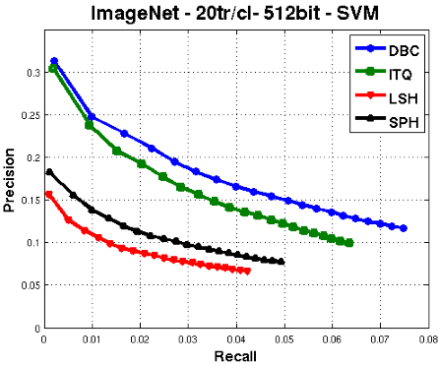
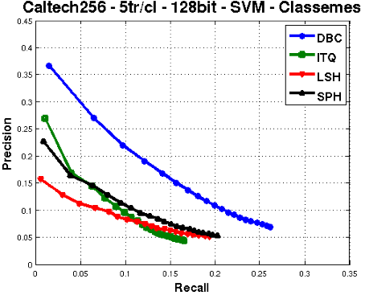
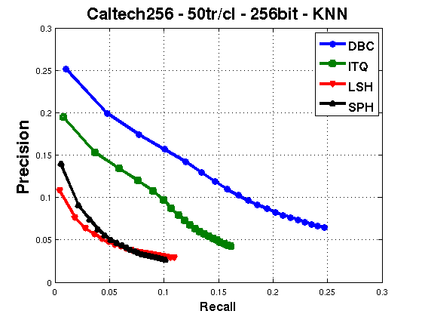
Comparison with bit-code methods

Slide 108
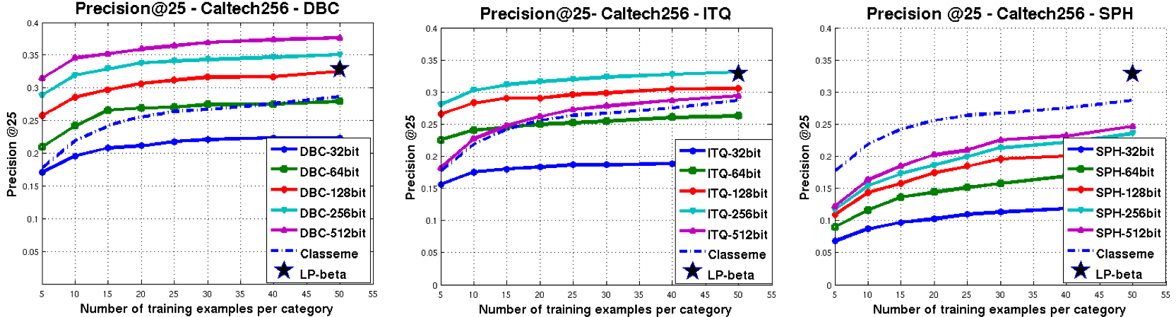
Comparison to State-of-the-Art
Rastegari, Farhadi, Forsyth, Attribute Discovery via Predictable Discriminative Binary Codes, ECCV12

Slide 109
Novel Category Recognition
Image net as auxiliary dataset
Rastegari, Farhadi, Forsyth, Attribute Discovery via Predictable Discriminative Binary Codes, ECCV12

Slide 110
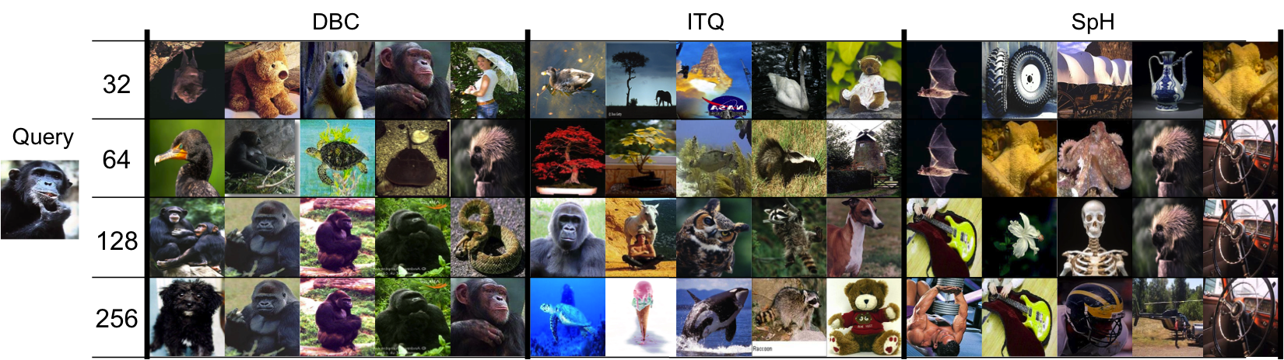
Qualitative Result of Image Retrieval
Rastegari, Farhadi, Forsyth, Attribute Discovery via Predictable Discriminative Binary Codes, ECCV12

Slide 111
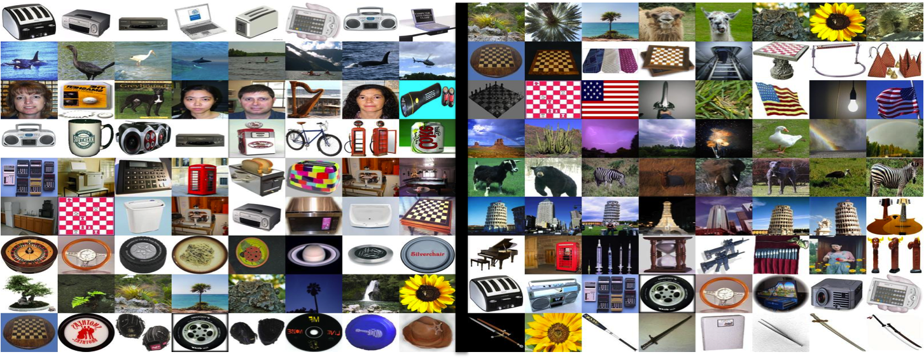
Qualitative Results of Attribute Discovery
Rastegari, Farhadi, Forsyth, Attribute Discovery via Predictable Discriminative Binary Codes, ECCV12

Slide 112
What to learn
Vocabulary of attributes
Learn the attribute models
Use Attributes
Find useful bits
Attach semantics to the bits
Use Attributes
Rastegari, Farhadi, Forsyth, Attribute Discovery via Predictable Discriminative Binary Codes, ECCV12

Slide 113
Instance-Level Attributes
Significant variations in a category
Interesting stuff are often the instance specific ones

Slide 114
Disjoint Semantic and Discriminative Attributes

Slide 115
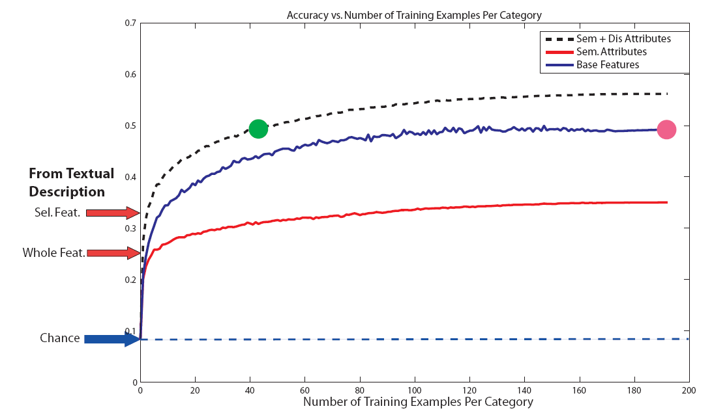
Farhadi et.al. CVPR 2009

Slide 116

Viktoriia Sharmanska, Novi Quadrianto, Christoph H. Lampert: "Augmented Attribute
Representations", ECCV12

Slide 117

Viktoriia Sharmanska, Novi Quadrianto, Christoph H. Lampert: "Augmented Attribute
Representations", ECCV12

Slide 118

Viktoriia Sharmanska, Novi Quadrianto, Christoph H. Lampert: "Augmented Attribute
Representations", ECCV12

